Slide 1
Predicting Postsecondary Institutional Graduation Rates
Stefanie Colino
CS5100 Project Presentation

Slide 2

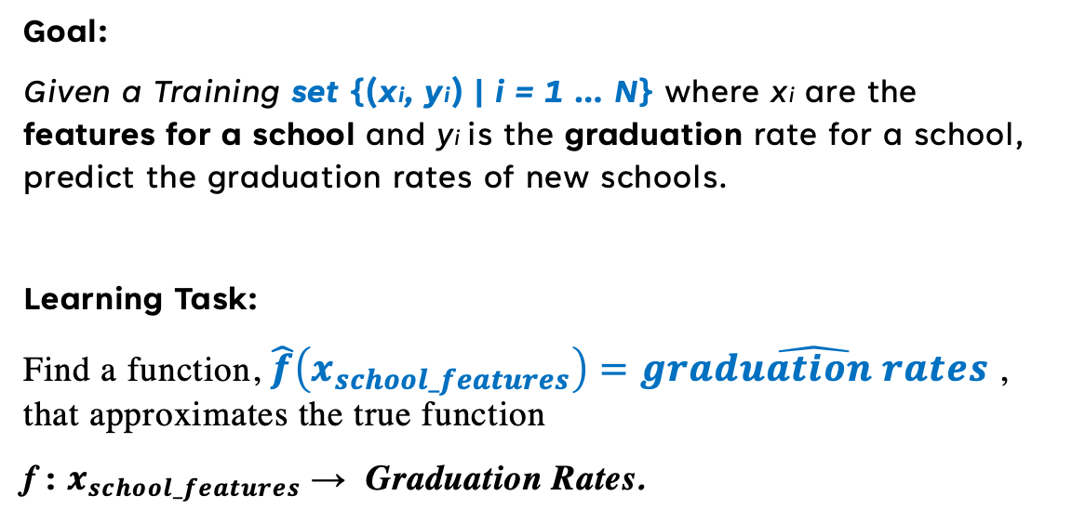
Problem Statement
Goal:
Given a Training set {(xi, yi) | i = 1 … N} where xi are the features for a school and yi is the graduation rate for a school, predict the graduation rates of new schools.
Learning Task:
Find a function, $\hat{f}\left(x_{school_features}\right)=\hat{graduation rates}$, that approximates the true function
f : $x_{school_features}$→ Graduation Rates.
Why we Care:
Graduation rates can be indicative of the quality of education
Identifying driving factors can help school improve

Slide 3
Data
IPEDS (Integrated Postsecondary Education Data System)
National Center for Education Statistics
Predictive Features
Institutional Characteristics
Library Resources
Diversity of Student Body
Diversity of Instructors
Tuition Rates
Financial Characteristics
Graduation Rates for the 2015 full-time, first-time undergraduate cohort from the 2021-2022 dataset
Total Schools: 1767
Predictive features from the 2016-2017 dataset
Total Predictive Variables: 234
Notes:
School include private non-profit, private for-profit, public

Slide 4
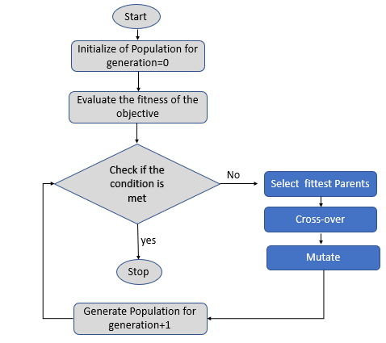
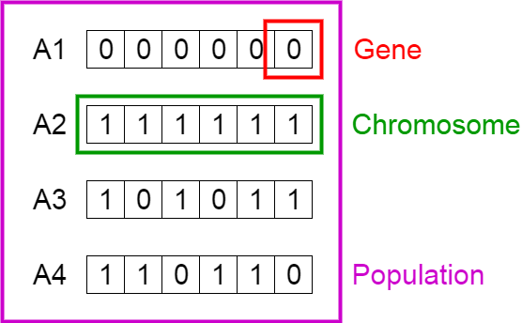
Algorithms
Primary Algorithms: Decision Tree Regressor, Linear Regression
Objective: Minimize Mean Squared Error
Secondary Algorithm: Genetic Algorithms for Variable Selection
MSE
Each gene represents the presence of a predictive feature.
Evaluate Fitness

Slide 5
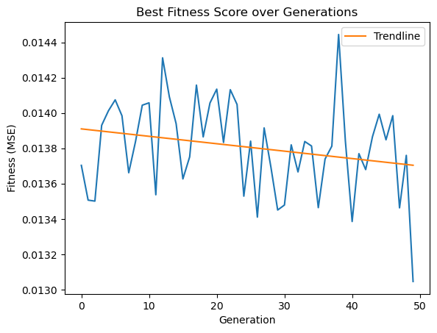
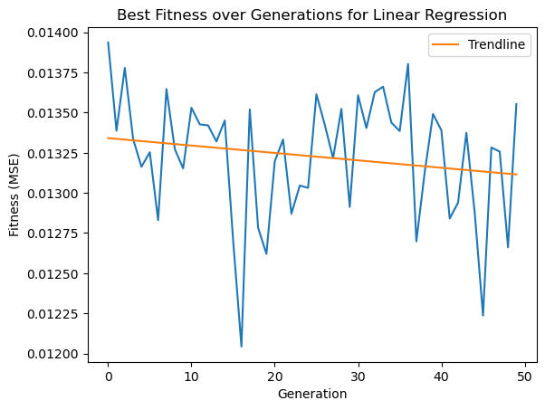
Results
Baseline Results:
Decision Tree* |  | Linear Regression
RMSE | .12 | RMSE | .127
R-Squared | .616 | R-Squared | .569
Predictive Features after 50 generations: 107
* Min Samples for a leaf set to 45
Best Fitness: .0126 MSE -> .112 RMSE
Best Fitness: .013 MSE -> .114 RMSE

Slide 6
Final Steps
Assess the features that the algorithm selected
Run the genetic algorithm with adjusted parameters.

